Slide 1
COM3571 Data visualization
Data and Tasks
Dr. Van Kelly

Slide 2

Assignment 1
Posted on Canvas
Due Friday, Feb. 9
Get started soon!
Submission information will be posted
Useful reference: Interactive Data Visualization for the Web by Scott Murray

Slide 3
Recap
“Computer-based visualization systems provide
visual representations of datasets designed to help people carry out tasks more effectively.”
— T. Munzner

Slide 4
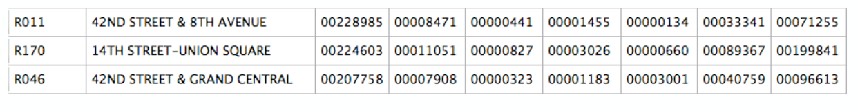
Data
What is this data?
Semantics: real-world meaning of the data
Type: structural or mathematical interpretation
Both often require metadata
Sometimes we can infer some of this information
Line between data and metadata isn’t always clear

Slide 5
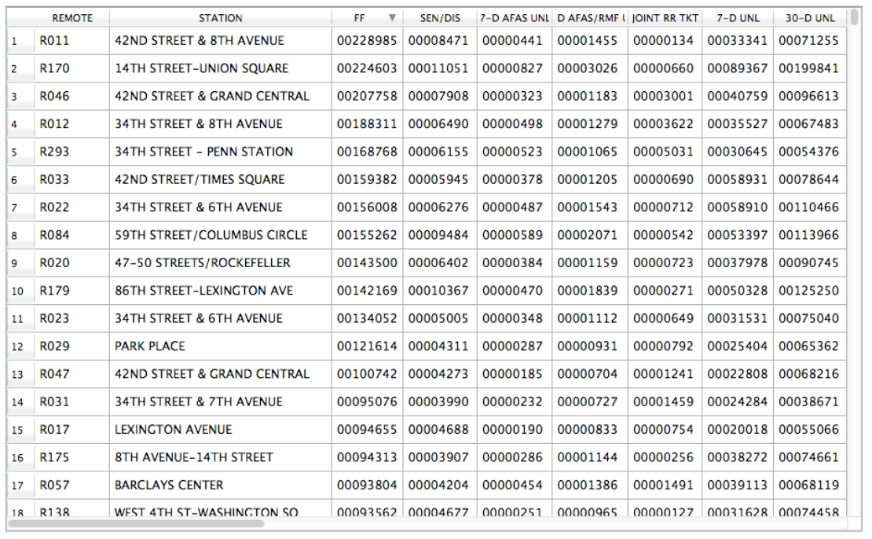
Data

Slide 6
Data Types
Items
An item is an individual discrete entity
e.g. row in a table, node in a network
Attributes
An attribute is some specific property that can be measured, observed, or logged
a.k.a. variable, (data) dimension
Cells
A cell is the value of one attribute of one item

Slide 7
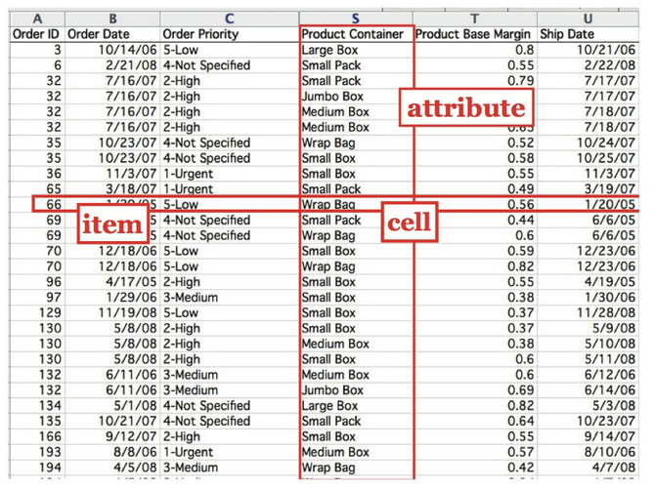
Items, Attributes, & Cells

Slide 8
Data Types
Nodes (a.k.a. vertices)
Synonym for item but in the context of networks (graphs)
Links (a.k.a. edges)
A link is a relation between two items
e.g. social network friends, computer network links
may be annotated as an item in its own right

Slide 9
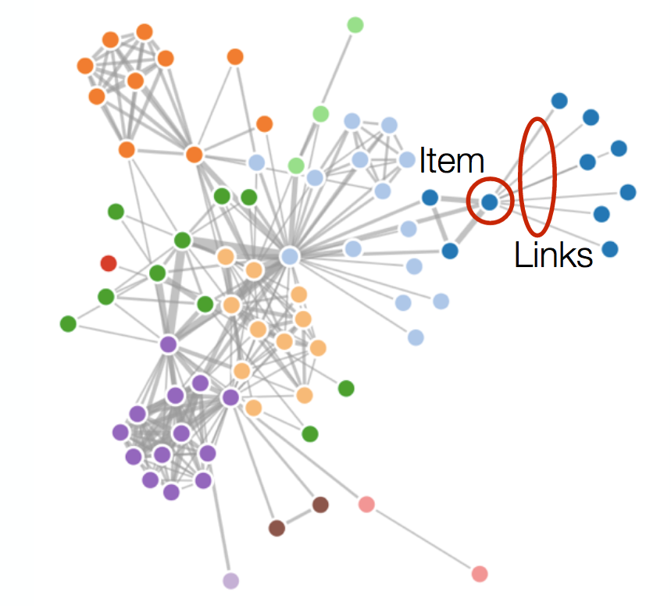
Nodes and Links
Node

Slide 10
Positions and Grids
Positions:
A position is a location in space (usually 2D or 3D)
May be subject to projections
e.g. cities on a map, a sampled region in an CT scan
Grids:
A grid specifies how data is sampled
may be geometric or topological
e.g. how CT scan data is stored
mapping from some domain onto positions

Slide 11
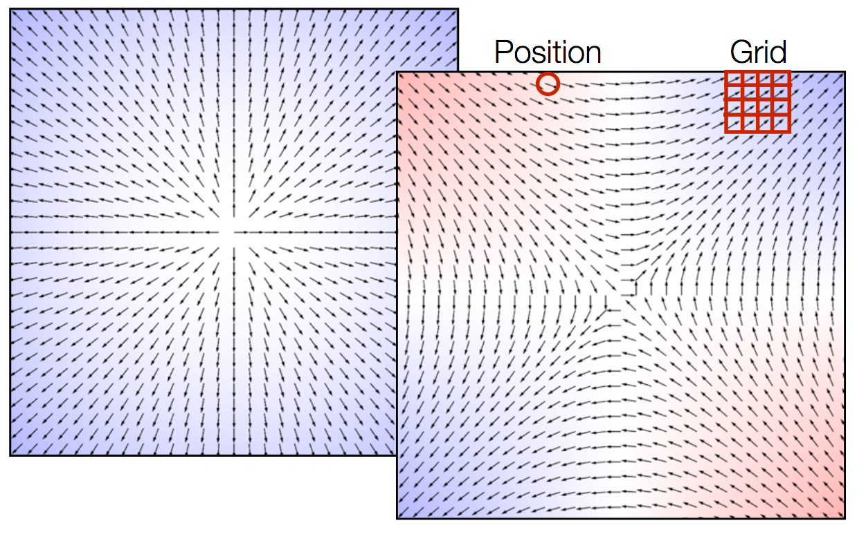
Positions and Grids

Slide 12
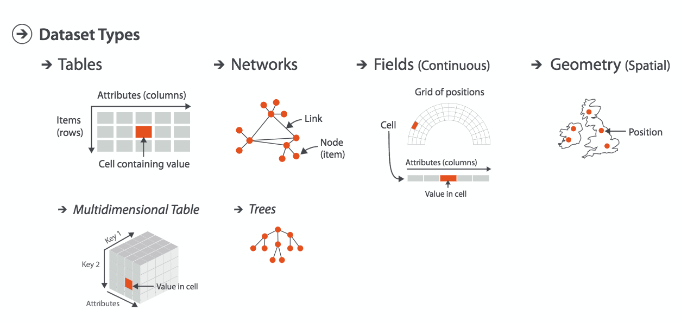
Dataset Types

Slide 13
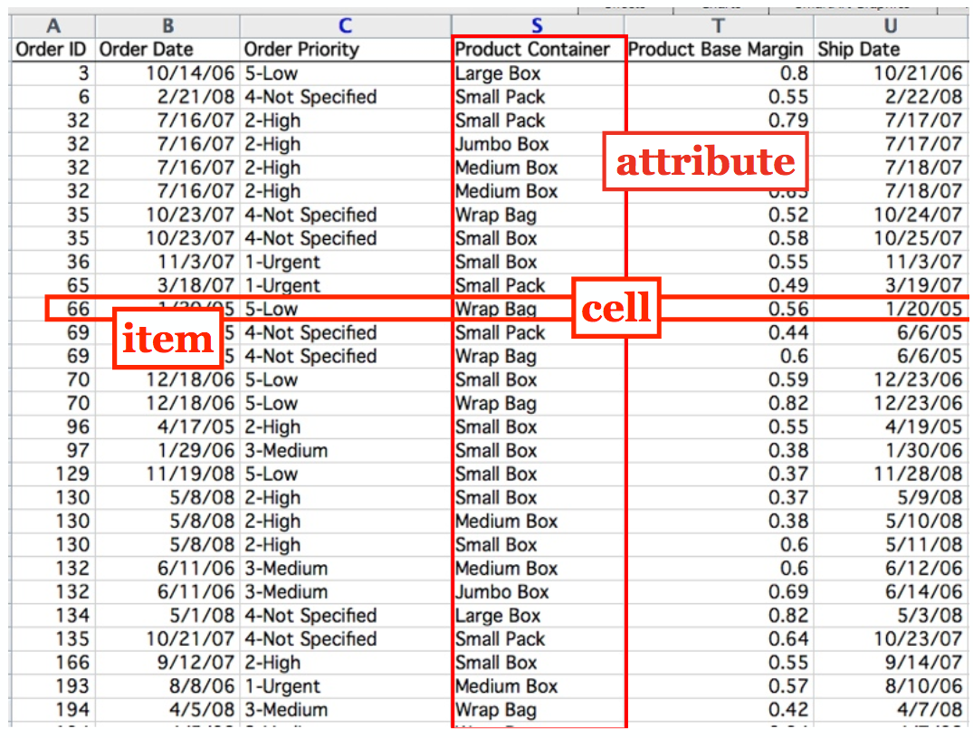
Tables

Slide 14
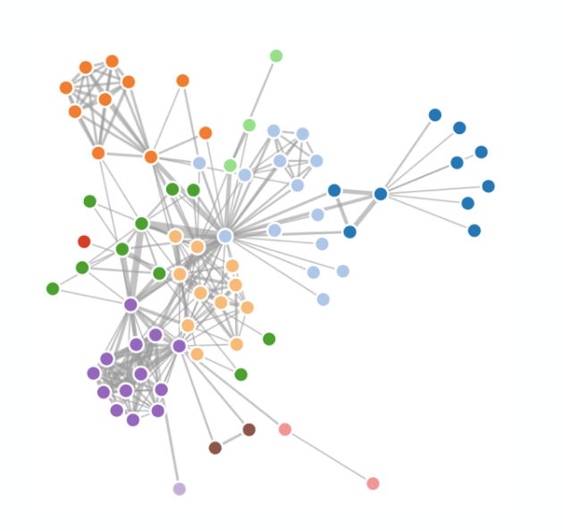
Networks
Why networks instead of graphs?
Tables can represent networks
Many-many relationships
Also can be stored as specific graph databases or files

Slide 15
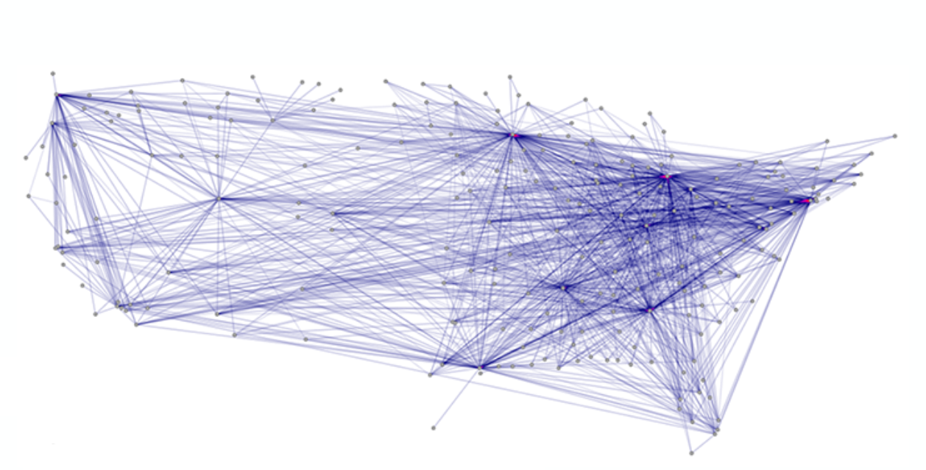
Networks

Slide 16
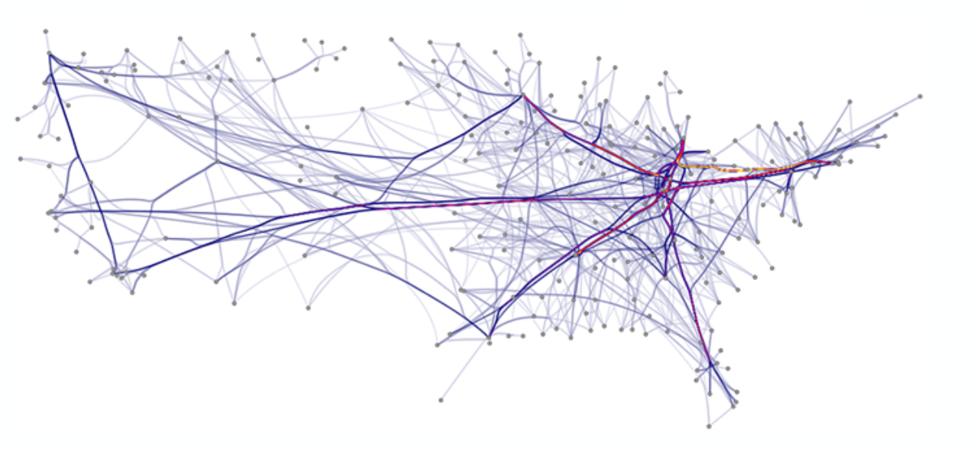
Networks

Slide 17
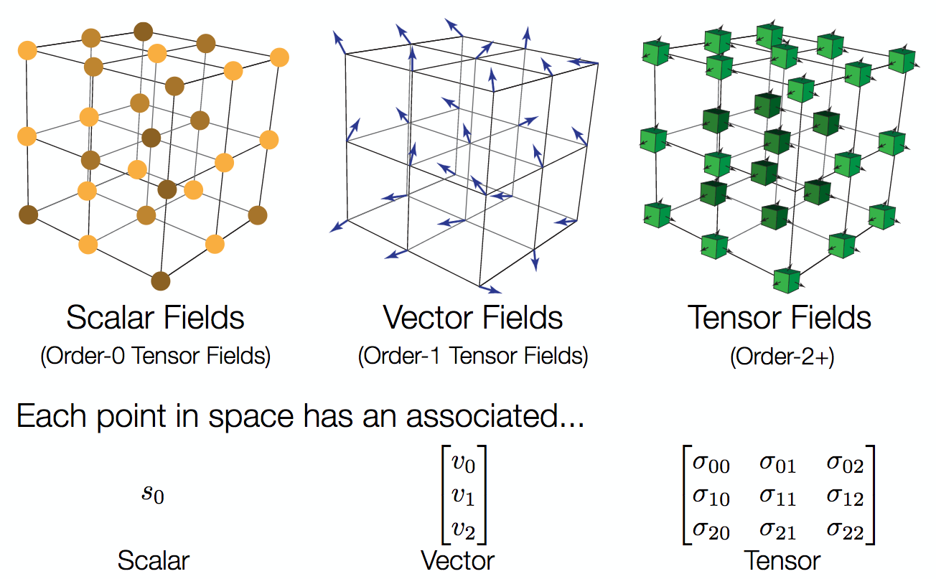

Fields

Slide 18
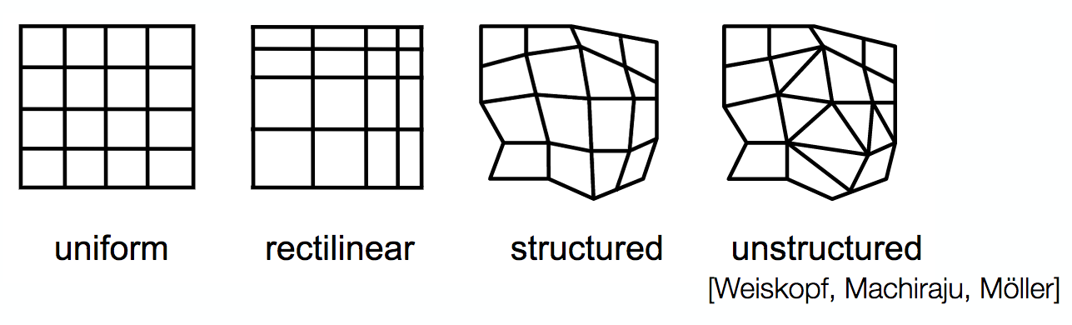
Fields
Difference between continuous and discrete values
Examples: temperature, pressure, density
Grids necessary to sample continuous data
Interpolation: "how to show values between the sampled points in ways that do not mislead"

Slide 19
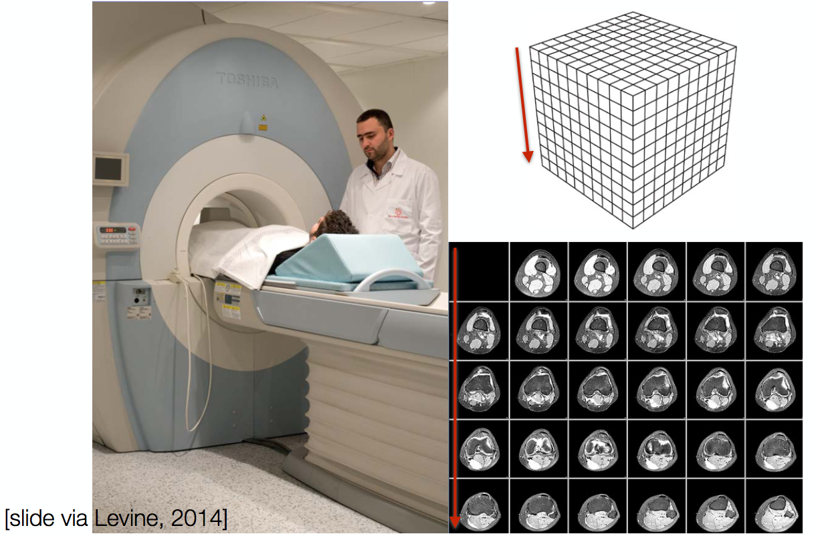
Spatial Data Example: MRI

Slide 20
Scivis vs. Infovis
Two subfields of visualization
Scivis deals with data where the spatial position is given with data
Usually continuous data
Often displaying physical phenonema
Techniques like isosurfacing, volume rendering, vector field vis
In Infovis, the data has no set spatial representation
designer chooses how to use space to visually represent data

Slide 21
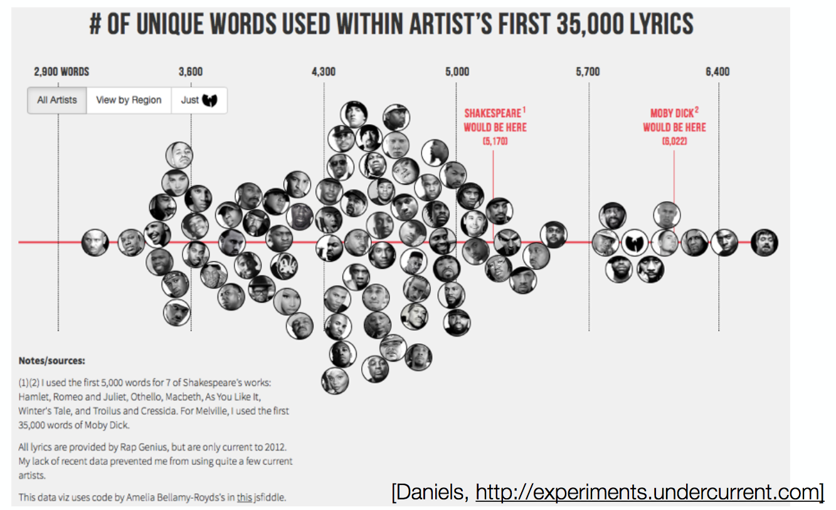
Sets and Lists

Slide 22
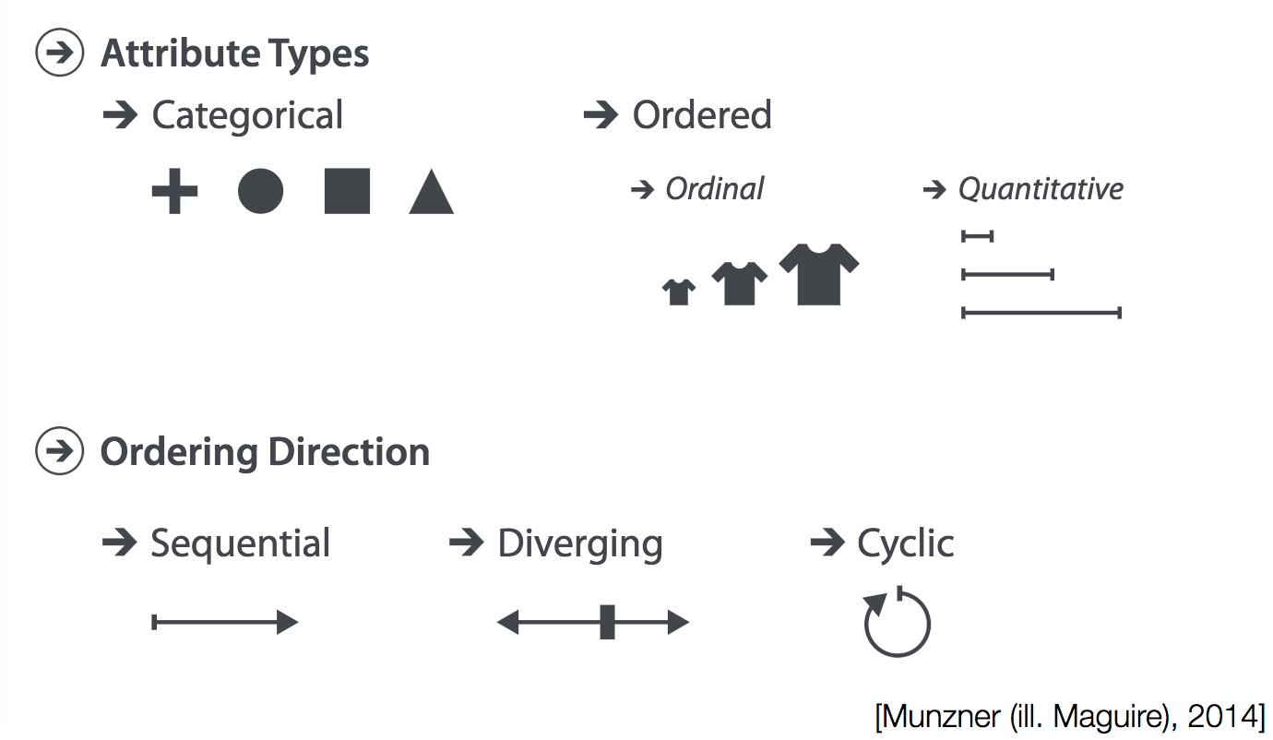
Attribute Types

Slide 23
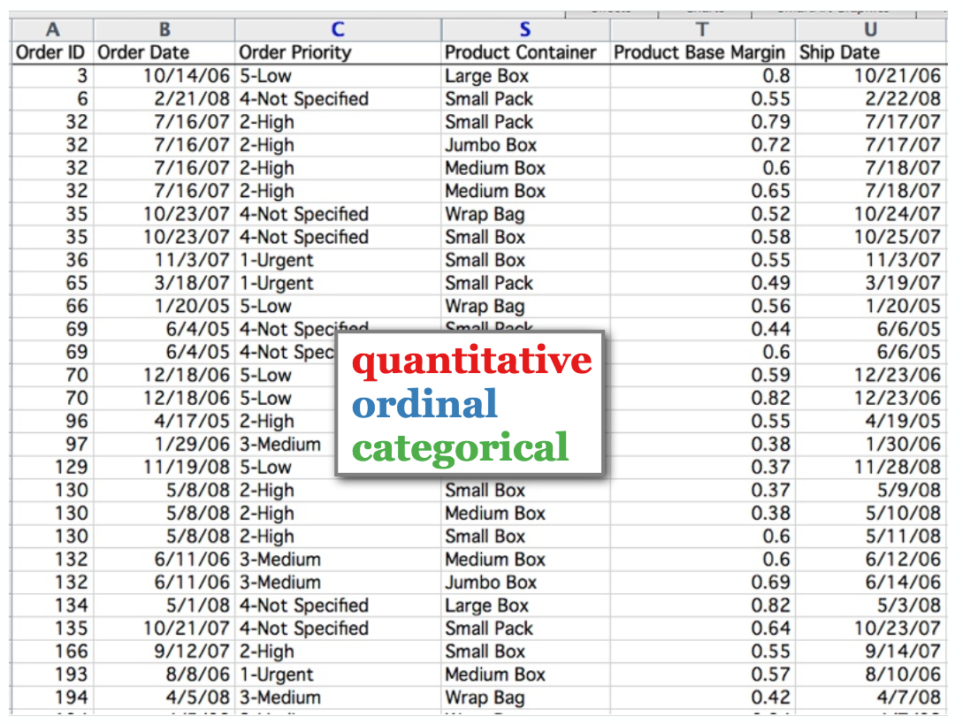
Categorical, Ordinal or Quantitative?

Slide 24
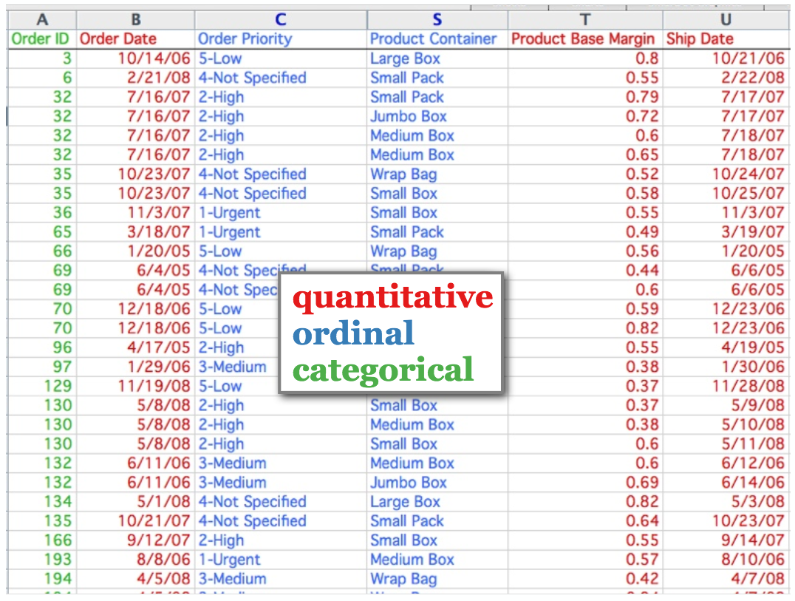
Categorical, Ordinal or Quantitative?

Slide 25

Tasks
Always an action and a target
discover distribution
compare trends
locate outliers
browse topology
identify shape
summarize extremes

Slide 26
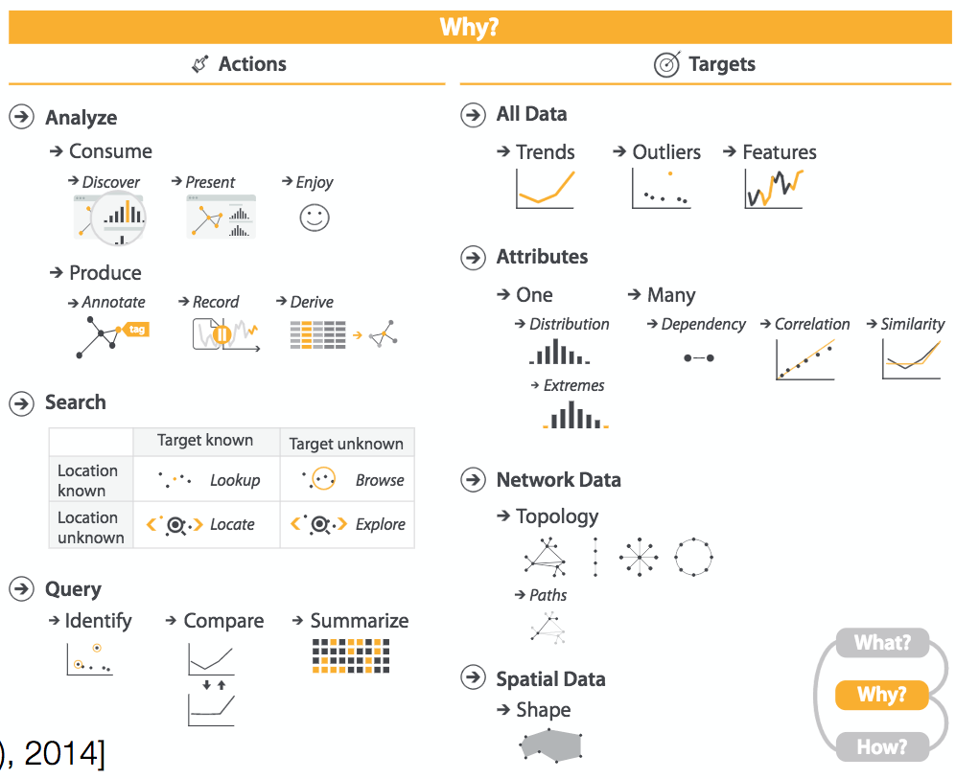



Slide 27
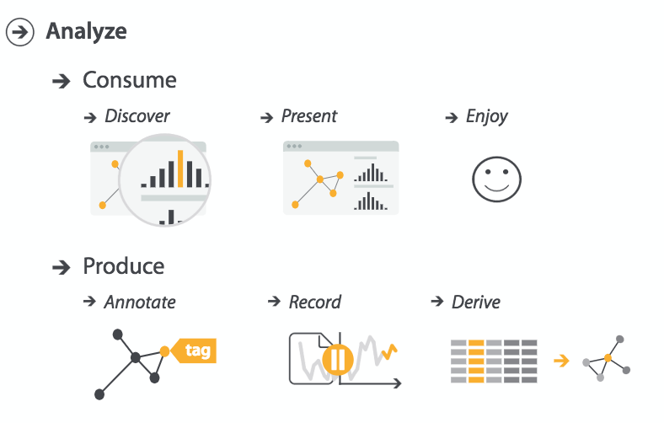
Actions: Analyze
Consume
Exploration
Explanation
Enjoyment
Produce
Annotation
Record
Derivation
Leads to new directions/ideas

Slide 28
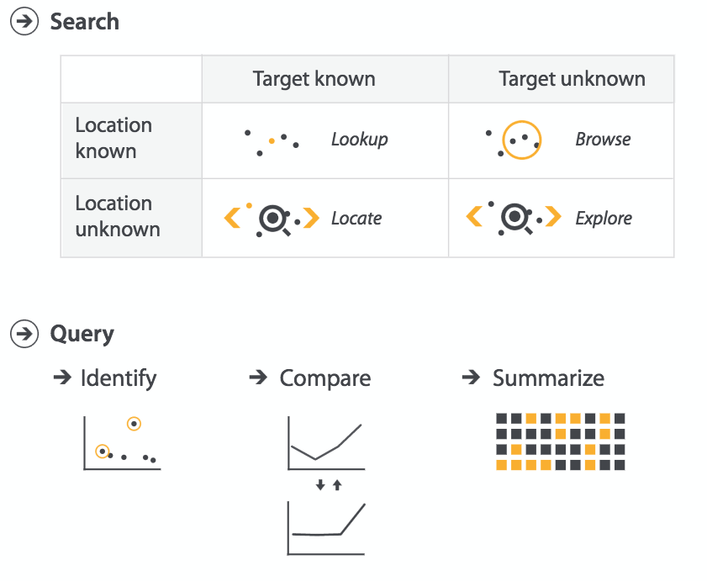
Actions: Search and Query
Search based on what a user knows
Target
Location
Query depends on what data matters
One
Some (Often Two)
All

Slide 29
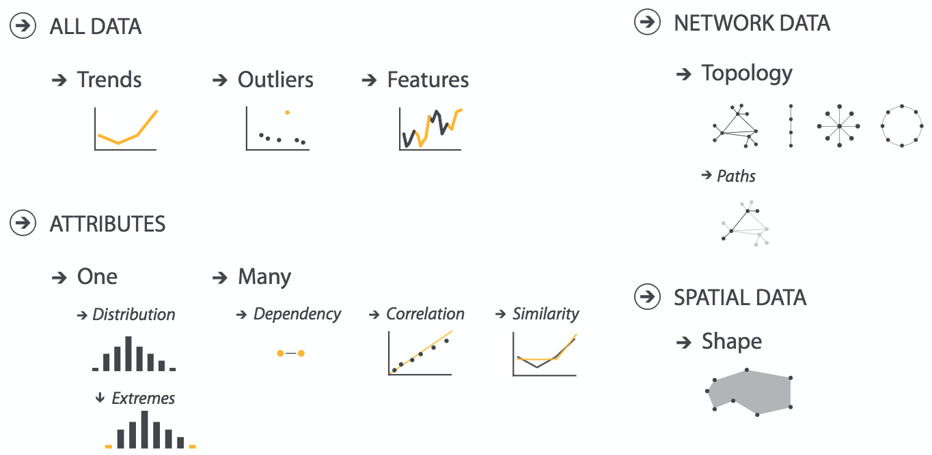
Targets

Slide 30
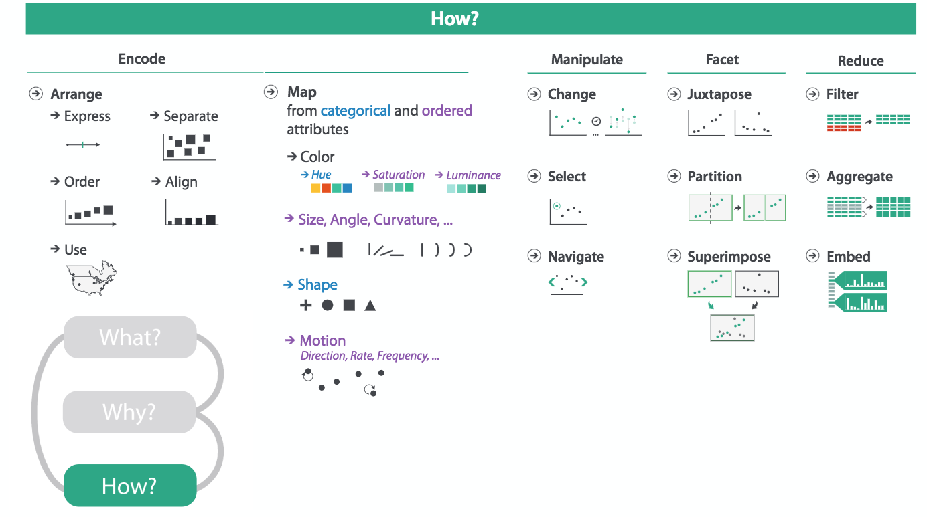

Slide 31
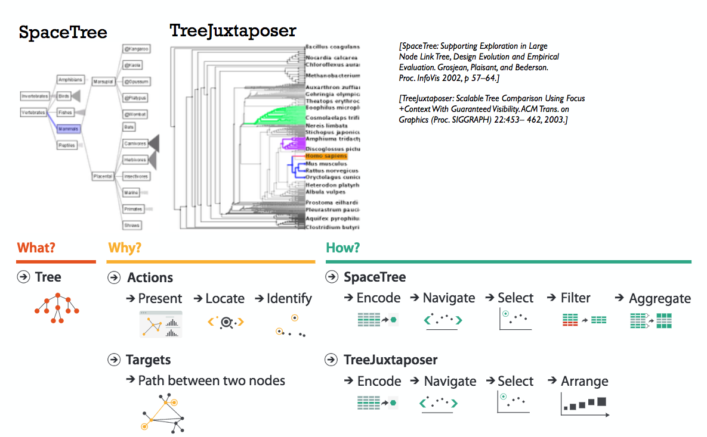
Analysis Example

Slide 32
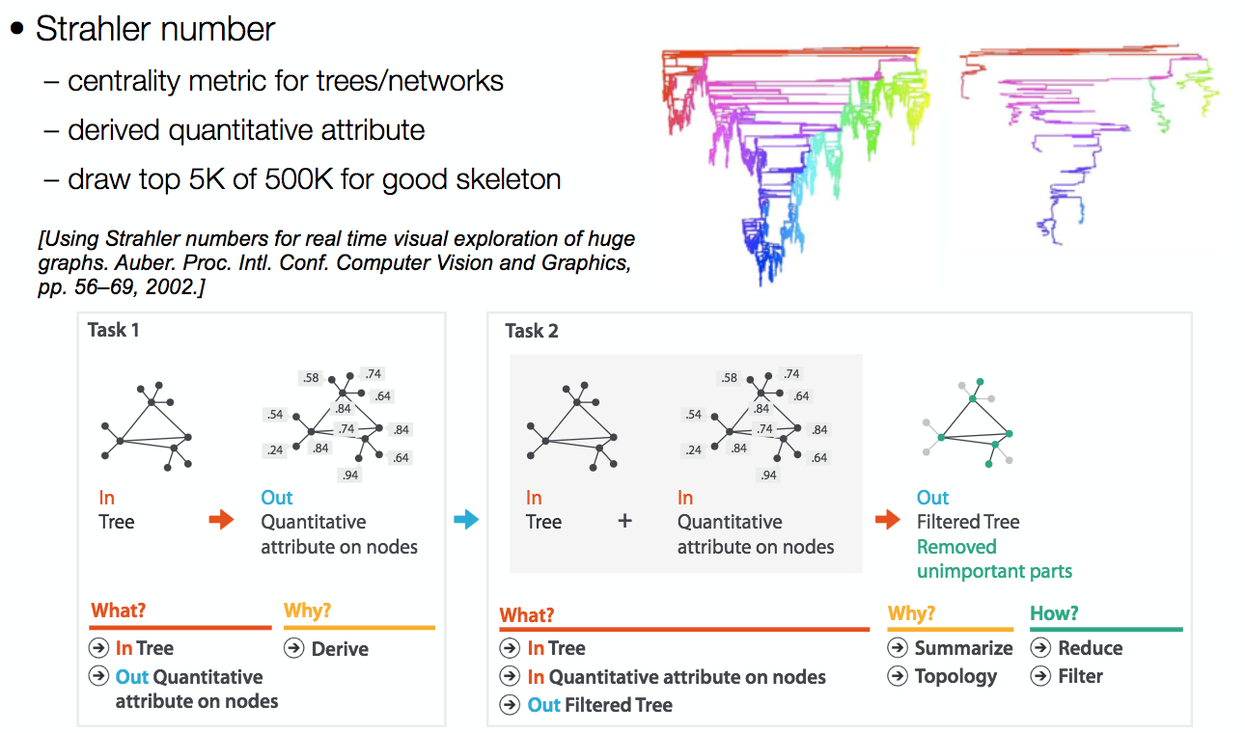
Analysis Example: Derivation

